Slide 1
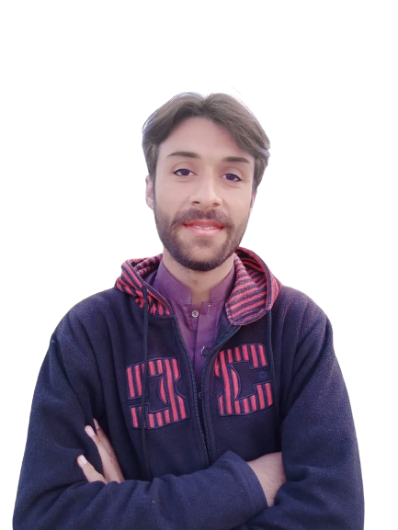
Complex Task Series
Problem Number 71

Slide 2
Problem Statement
Write A Web application in Python Program to get 6 subject marks from the user and calculate total and average of that marks. And display to user.

Slide 3
Algorithm
Step1: Install Python Django Library
Step2: Create Project
Step3: Create Application And Include In Settings.Py File In Django Project
Step4: Create Template Directory In Application
Step5: Create HTML File In Application Template
Step6: Create Form to get User subject marks
Step7: Write view for HTML file in views.py
Step8: Find total and average of user marks
Step9: Write URL for Home view in urls.py
Step10: Display Result to User
END

Slide 4
Assignment
Write A Desktop application in Python to get 6 subject marks from the user and calculate total and average of that marks. And display to user.

